Slide 1
EE-357: CCN Mobile Radio Propagation: Large Scale Path Loss
Hassaan Khaliq Qureshi
School of Electrical Engineering & Computer Science
National University of Sciences & Technology (NUST)
Pakistan

Slide 2
Free-Space Propagation

Slide 3
Antennas
An antenna can be defined as an electrical conductor or system of conductors used either for radiating EM energy into space or collecting EM energy from space.
In two way communications, the same antenna is used for transmission and reception of a signal.
However, antenna characteristics are essentially the same whether an antenna is sending or receiving electromagnetic energy.

Slide 4
Radiation Pattern
An antenna will radiate power in all directions but typically does not perform well in all directions.
However, performance of an antenna is characterized by using an idealized antenna known as Isotropic antenna.
The actual size of the radiation pattern is arbitrary. What is important is the relative distance from the antenna position in each direction.

Slide 5
Radiation Pattern
The relative distance determines the relative power and a line or a vector is drawn to determine the relative power in each direction.
In case of an isotropic antenna, the relative distance remains same.
However, for directional antennas such as hertz antenna, the relative distance is not same.

Slide 6
Radiation Pattern
The radiation pattern provides a convenient means of determining the beam width of an antenna.
The beam width is a common measure to determine the directivity of an antenna.
When an antenna is used for reception, the antenna radiation pattern becomes reception pattern.

Slide 7
Free-Space Propagation
In general, different versions of a radio signal arrive at a receiver due to reflections from objects between the transmitter and the receiver
For the moment, we will not consider propagation effects due to these multiple signal
Instead, we will first model propagation effects for a free-space environment in which the wireless transmitter and receiver have only one Line of Sight (LoS) path between them
Such a model is fairly realistic in a satellite communication scenario
Later in the lectures (if time allows), we will incorporate multiple signal paths into our model

Slide 8
Free-Space Propagation: Isotropic Antenna
We first consider the simple case of an isotropic antenna that transmits equal power in all directions
If the isotropic transmitter emits a radio signal with power P_{T} watts, what is the power received by the receiver’s antenna?
In other words, what parameters impact received signal power?
Transmitter
Receiver

Slide 9
Free-Space Propagation: Isotropic Antenna
For an isotropic antenna with power P_{T}, what parameters impact received signal power?
Received power should be a function of two parameters:
Power Flux Density: How much of the total emitted power is flowing in the receiver’s direction?
Receiver’s Antenna Orientation: What is the size and orientation of the receive antenna with respect to the transmitter’s transmission sphere?
Transmitter
Receiver

Slide 10

Free-Space Propagation: Isotropic Antenna
Transmitter’s power flux density is simply the amount of power per unit area appearing within the transmission sphere
The surface area of the transmission sphere is: 4πR²
where R is the transmission radius of the transmitter
Power flux density in a unit area is then:
Transmitter
Receiver
Notes:
This formula was first derived by Archimedes, based upon the fact that the projection to the lateral surface of a circumscribing cylinder (i.e. the Lambert cylindrical equal-area projection) is area-preserving. It is also the derivative of the formula for the volume with respect to r because the total volume of a sphere of radius r can be thought of as the summation of the surface area of an infinite number of spherical shells of infinitesimal thickness concentrically stacked inside one another from radius 0 to radius r. At infinitesimal thickness the discrepancy between the inner and outer surface area of any given shell is infinitesimal and the elemental volume at radius r is simply the product of the surface area at radius r and the infinitesimal thickness.

Slide 11
Free-Space Propagation: Isotropic Antenna
The power flux density depends on the transmission radius
However, the receiver’s antenna generally does not cover the entire transmission radius of the transmitter
No overlap
Perfect overlap

Slide 12
Free-Space Propagation: Isotropic Antenna
Averaging the two extreme cases (perfect overlap, no overlap), we get the average case scenario shown below
On average, the transmission radius, R, of the transmitter can be treated as being equal to the Transmitter-Receiver (T-R) separation, d
Average overlap

Slide 13
Free-Space Propagation: Isotropic Antenna
Then the power flux density equation can be rewritten as:
Note that theoretically we can always set R=d
If R is small => power flux density will be higher
If R is large => power flux density will be lower
Average overlap

Slide 14
Free-Space Propagation: Isotropic Antenna
Due to a receive antenna’s size and orientation towards the transmitter, it cannot absorb all the electromagnetic waves in its physical area
In effect, the receiver’s antenna absorbs radio waves in an effective aperture or effective area A_{e} m²
Thus the power at the receiver is:
Physical Area
Transmitter
Receiver
Notes:
Exercise: What power is received at the receiver when a transmitter uses a 50W of power and receiver is located at a distance of 40 meters. The effective area of receiver antenna is 2 m*m.

Slide 15
Free-Space Propagation: Isotropic Antenna
Effective area of an isotropic antenna is
Therefore its received power is:
T-R separation, d
Physical Area
Transmitter
Receiver
Notes:
If the receive antenna’s physical area is A m² , then antenna efficiency is defined as:
Antenna Efficiency n= Effective Area (A_{e})/Total Physical Area (A)
Antenna efficiency typically varies from 40%-80% for different antenna designs

Slide 16
Free-Space Propagation: Isotropic Antenna
In other words, received power can be written as
Where L_{p} is the path loss:
T-R separation, d
Physical Area
Transmitter
Receiver

Slide 17
Free-Space Propagation: Isotropic Antenna
Note that path loss is:
Directly proportional to transmission radius; and
Inversely proportional to transmission wavelength.
T-R separation, d
Physical Area
Transmitter
Receiver
Notes:
This is the indication why at the lower frequencies the path loss is also less. See the above equation and relate path loss with wavelength.
Exercise: If a transmitter produces 50 W of power, express the transmit power in units of dBm and dBW.
dB and dbW are the same thing: the normalization factor is 1 Watt
P_{T}(dB) = 10 log(50W/1W) = 10xlog(50) – 10 log(1) = 16.989 dBW
In dBm, the normalization factor is 1 milli Watts
P_{T}(dBm) = 10 log(50x10³mW/1mW)=10xlog(50) +30 log(10)=46.989 dBm

Slide 18
Free-Space Propagation: Directional Antenna
Most antennas are not ideally isotropic and have a gain or directivity that is a function of:
Azimuth angle of the antenna, φ
Elevation angle of the antenna, θ
The directivity of the antenna typically has a parabolic shape
Main lobe
θ
Side lobes
θ
Transmitter
φ
Notes:
An azimuth (^{i}/ˈæzɪməθ/; from Arabic السمت meaning "a way, a part, or quarter“ is an angular measurement in a spherical coordinate system. The vector from an observer (origin) to a point of interest is projected perpendicularly onto a reference plane; the angle between the projected vector and a reference vector on the reference plane is called the azimuth.
Azimuth” for a better example of “parallel to the earth’s horizon” i.e. the space it is providing on surface

Slide 19
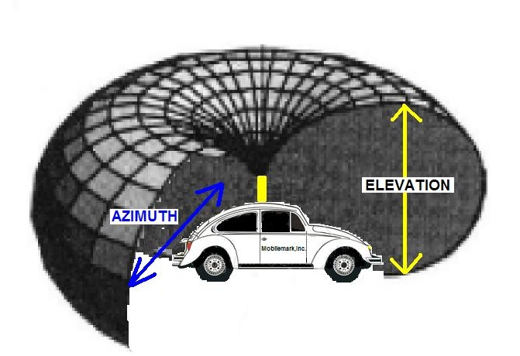
Free-Space Propagation: Directional Antenna
Transmit side antenna gain is defined as:
Notes:
The figure shows the azimuth radiated energy and elevated radiated energy
Ae= Power at the terminals of the receiving antenna/power flux density
The wave being polarization matched to the antenna.
Effective area changes in case there is a polarization mismatch……………………….

Slide 20
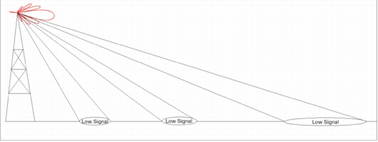
Free-Space Propagation: Directional Antenna
Receive side antenna gain is defined as:
Notes:
In the above example, we are taking the case of an isotropic antenna and therefore this term will lead to gain being equal to 1 as effective area in direction remains the same as effective area of an isotropic antenna. However, effective area of different antennas varies according to their types and so as their gains also changes.
For further reading, students are recommended to see Table 5.2 (William Stallings) and solve Example 2.2 of the course book.

Slide 21
Free-Space Propagation: Directional Antenna
The principle of reciprocity in electromagnetic field theory states that the transmit and receive side gains of an antenna are the same
Main lobe
Side lobes
Transmitter

Slide 22
Free-Space Propagation: Friss Equation
Recall that:
Since there are directional gains on the transmit and receive sides for directional (non-isotropic) antennas, the received power is:
Friis Equation
d
R
T
Notes:
For a parabolic reflective antenna with a diameter of 2m, operating at 12Ghz and transmitting at 50W, what is the antenna gain and path loss when effective area is 0.56Pi. Also calculate the power received by the antenna? (Assume both gains being equal [however this is not correct See Gain Table for different antennas]).
Solution: Use the Antenna gain G equation to calculate antenna gain. For path loss, use your previous knowledge to calculate the T-R distance d. Do not get yourself confuse with distance d and diameter.

Slide 23
Free-Space Propagation: Link Budget Equation
The decibel notation of the Friss equation is:
Link Budget

Slide 24
Free-Space Propagation: Link Budget Equation
The phrase “Closing the link” refers to the requirement that the received power is greater than the receiver sensitivity.
In terrestrial microwave links, line of sight transmission limits the separation of T and R to about 40Km. If a 100 mW transmitter at 4 GHz is used with transmitting and receiving antennas of 0.5 m*m effective area. What is the received power level in dBm.
Solution: Use the basic Friss equation to calculate the Answer.
Notes:
Right hand side provides enough power at the receiver to detect the transmitted information.

Slide 25
Example
If 50 W is applied to a unity gain antenna with 900 MHz carrier frequency, find the received power in dBm at a free space distance of 100m from the antenna.
Solution: Use the Friss equation to calculate the answer.

Slide 26
Example
If 50 W is applied to a unity gain antenna with 900 MHz carrier frequency, find the received power in dBm at a free space distance of 100m from the antenna.

Slide 27
Example
If 50 W is applied to a unity gain antenna with 900 MHz carrier frequency, find the received power in dBm at a free space distance of 100m from the antenna.

Slide 28
Free-Space Propagation: Beamwidth
A directional antenna cannot absorb radiations in its entire area
Maximum (peak) gain is achieved along the axis of the parabola
Gain decreases as you move away from the axis
Beamwidth is defined as the angular width at which the antenna gain falls to half of (i.e., 3 dBs less than) its peak value
i.e.: 10 log(P_{T}/2) = P_{T}(dB) – 3.01dB
3dB beamwidth

Slide 29
Free-Space Propagation: Beamwidth
Beamwidth is a measure of the effective area in which the antenna can absorb EM waves
3-dB beamwidth of an ideal parabolic dish antenna is
D is the diameter of the dish
3dB beamwidth

Slide 30
Free-Space Propagation: Beamwidth
Beamwidth is a function of the size or effective area of the antenna:
Large antenna => large effective area => large gain
Large antenna => large antenna diameter => Narrow beamwidth
3dB beamwidth

Slide 31
Free-Space Propagation: Beamwidth
Large antenna need to be pointed in a precise direction to make use of the gain [example:…..]
In general, 3-dB beamwidth is:
Directly (linearly) proportional to the signal wavelength
Inversely proportional to the antenna diameter
3dB beamwidth
Notes:
The ‘beam-width’ of an aperture antenna is influenced by the rule: the bigger the parabolic dish, the narrower the beam
It is this ability to focus, or collimate (collimate means ‘form into a column’ and describes the way the energy travels without much spreading), the energy into a narrow beam that endows the antenna with gain.
Consider an antenna that radiates the energy in a perfectly conical beam. If angle is small, a circle of diameter would be evenly illuminated at distance r.

Slide 32
Free-Space Model validitiy: Fraunhofer Distance
The Friis model is valid for values of T-R separation d > d_{f}, where d_{f} is given by
Fraunhofer distance
where D is the largest physical dimension (diameter) of the antenna
Some other constraints on d_{f} are:
Notes:
Only valid for far regions.
Near Field: a region in which there are strong inductive and capacitive effects from the currents and charges in the antenna

Slide 33
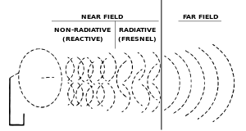

Slide 34
?
?
?
Questions/ Confusions?
Quote of the week
You never fail until you stop trying

